Slide 1
CSCI 561 Foundations of Artificial Intelligence Lecture 11-12: First-Order Logic (Chapter 8)
FALL 2018
Instructor:
Prof Sheila Tejada
Prof Wei-min shen
Prof Ning wang
cs561-l@mymaillists.usc.edu

Slide 2
Entailment proof with truth table AKA, Proof via model checking, enumeration
To prove a sentence, β
Start with the set of true sentences, the “knowledge base”
Join them all together as one big conjunction, α
Create a truth table for (α ⇒ β)
Verify that this sentence is True in all models.
Algorithm is sound: it directly implements the definition of entailment.
Algorithm is complete: it works for any sentence and always terminates.
However, you need 2^{n} rows, where n is the number of proposition symbols. For sentences with lots of symbols, we need a better approach.
2

Slide 3
Proofs using theorem proving
Applying rules of inference directly to the sentences in the KB to construct a proof of the desired sentences without consulting models.
Suitable when the number of models is large but the length of proof is short → Theorem proving can be more efficient than model checking.
Key concepts:
Logical Equivalence
Validity
Satisfiability
3

Slide 4
Important Tautologies Basic Manipulation Rules for Propositional Logic
α ⋀ β | ⟺ | β ⋀ α | Commutativity of ⋀
α ⋁ β | ⟺ | β ⋁ α | Commutativity of ⋁
(α ⋀ β) ⋀ γ | ⟺ | α ⋀ (β ⋀ γ) | Associativity of ⋀
(α ⋁ β) ⋁ γ | ⟺ | α ⋁ (β ⋁ γ) | Associativity of ⋁
¬(¬α) | ⟺ | α | Double-negation elimination
α ⇒ β | ⟺ | ¬β ⇒ ¬α | Contraposition
α ⇒ β | ⟺ | ¬α ⋁ β | Implication elimination
α ⟺ β | ⟺ | (α ⇒ β) ⋀ (β ⇒ α) | Biconditional elimination
¬(α ⋀ β) | ⟺ | ¬α ⋁ ¬β | De Morgan
¬(α ⋁ β) | ⟺ | ¬α ⋀ ¬β | De Morgan
α ⋀ (β ⋁ γ) | ⟺ | (α ⋀ β) ⋁ (α ⋀ γ) | Distributivity of ⋀ over ⋁
α ⋁ (β ⋀ γ) | ⟺ | (α ⋁ β) ⋀ (α ⋁ γ) | Distributivity of ⋁ over ⋀
4

Slide 5
Some inference rules
Modus ponens
“The way that affirms by affirming”
Modus tollens
“The way that denies by denying”
And-Elimination
“simplification”
Or-Introduction
“addition”
α ⇒ β, α
β
α ⇒ β, ¬β
¬α
α ⋀ β
α
α
α ⋁ β
5

Slide 6
Resolution Theorem Proving
Why the resolution inference rule?
From Inference Rules to Inference Algorithms
Soundness and Completeness
Resolution Inference – Complete when coupled with complete search algorithm
Resolution Rule
Conjunctive Normal Form (CNF)
6

Slide 7
Entailment as satisfiability
M(β)
M(α)
x
x
x
x
x
x
x
x
x
x
x
x
x
x
x
x
x
x
x
x
x
x
x
x
x
x
x
x
x
x
x
x
x
α ⊨ β if and only if the sentence (α ⇒ β) is valid.
(In all the worlds α is true, β must also be true. There is not a case that α is true but β is false.)
(α ⇒ β) is valid if and only if ¬(α ⇒ β) is unsatisfiable.
(α is valid if and only if ¬α is unsatisfiable.)
¬(α ⇒ β) ⟺ (α ⋀ ¬β)
Implication elimination: (α ⇒ β) ⟺ (¬α ⋁ β)
α ⊨ β if and only if the sentence (α ⋀ ¬β) is unsatisfiable.
x
⊨ = ⇒?
7

Slide 8
Truth table for basic logic connectives
⊨ = ⇒?
P | Q | ¬P | P ⋀ Q | P ⋁ Q | P ⇒ Q | P ⟺ Q
False | False | True | False | False | True | True
False | True | True | False | True | True | False
True | False | False | False | True | False | False
True | True | False | True | True | True | True
8

Slide 9
The resolution rule
Unit Resolution Inference Rule
Where l_{i} and m are complementary literals
Full Resolution Inference Rule
Where l_{i} and m_{j} are complementary literals
(l₁ ⋁ … ⋁ l_{k}), m
(l₁ ⋁ … ⋁ l_{i-1} ⋁ l_{i+1} ⋁ … ⋁ l_{k})
(l₁ ⋁ … ⋁ l_{k}), (m₁ ⋁ … ⋁ m_{n})
(l₁ ⋁ … ⋁ l_{i-1} ⋁ l_{i+1} ⋁ … ⋁ l_{k} ⋁ m₁ ⋁ … ⋁ m_{j-1} ⋁ m_{j+1} ⋁ … ⋁ m_{n})
9

Slide 10
Resolution Theorem Proving
To prove that KB ⊨ α, we show that (KB ⋀ ¬α) is unsatisfiable (see next slide)
Convert (KB ⋀ ¬α) to Conjunctive Normal Form
Apply the resolution rule wherever possible and add the result as an additional clause in the conjunction.
Repeat step 2 until either:
No new clauses can be added: KB does not entail α.
Two clauses resolve to yield the empty clause: KB entails α.
Unit clause: a clause with only one literal, e.g. (¬Q)
No new clauses can be added: no complementary literals left. Can find a model where (KB ⋀ ¬α) is satisfied. Thus can not prove contradiction.
Empty clause: a clause with no literals. Arises only through the resolution of two unit clauses with complimentary literals, e.g., (¬Q) ⋀ (Q), which indicates a contradiction. Means (KB ⋀ ¬α) is unsatisfiable.
10

Slide 11
Resolution Theorem Proving with Definite and Horn Clauses
Resolution theorem proving can take exponential time in worst case. However, most of the time, we don’t need full resolution theorem proving.
KB as special CNF: each clause is a Horn clause.
A clause with at most one positive literal. Example: ¬P ⋁ ¬Q ⋁ ¬R ⋁ ¬S
Horn clauses can be written as implication form.
E.g., (¬P ⋁ ¬Q ⋁ ¬R ⋁ ¬S) is equivalent to (P ⋀ Q ⋀ R ⇒ ¬S)
Each sentence in KB is now in implication form
Easy for human to read and understand
Entailment proving with Horn clauses is linear in the size of KB
Can only ask atomic queries, e.g., (KB ⋀ ¬α) is still in Horn form
Inference with Horn clause can be done with forward chaining and backward chaining algorithms
11

Slide 12
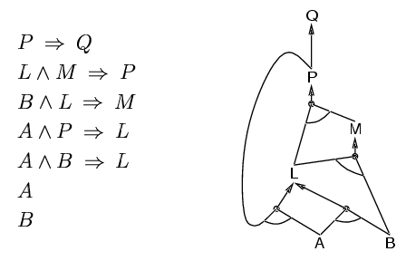
Forward chaining
Fire any rule whose premises are satisfied in the KB
Add its conclusion to the KB, until query is found
KB:
⋁
⋀
Query: Q
AND-OR Graph
12

Slide 13
Backward Chaining
Forward chaining: starts at KB, can generate a lot of irrelevant conclusions
Backward chaining: Work backwards from the query
Find all the implications where the premise includes the query
Prove all the premises of the implications
To Avoid loops
check if new subgoal is already on the goal stack
To avoid repeated work
check if new subgoal has already been proved true
Complexity of BC can be much less than linear in size of KB
13

Slide 14
Entailment as satisfiability
M(β)
M(α)
x
x
x
x
x
x
x
x
x
x
x
x
x
x
x
x
x
x
x
x
x
x
x
x
x
x
x
x
x
x
x
x
x
α ⊨ β if and only if the sentence (α ⇒ β) is valid.
(In all the worlds α is true, β must also be true. There is not a case that α is true but β is false.)
(α ⇒ β) is valid if and only if ¬(α ⇒ β) is unsatisfiable.
¬(α ⇒ β) ⟺ (α ⋀ ¬β)
α ⊨ β if and only if the sentence (α ⋀ ¬β) is unsatisfiable.
x
P | Q | ¬P | P ⋀ Q | P ⋁ Q | P ⇒ Q | P ⟺ Q
False | False | True | False | False | True | True
False | True | True | False | True | True | False
True | False | False | False | True | False | False
True | True | False | True | True | True | True
⊨ = ⇒?
14

Slide 15
Today: First-order logic
Constants, predicate, functions, terms, variables, sentences
Predicate-Argument Relations
Logical connectives
Quantifiers
Axioms and theorems
Domain, model and interpretation
15

Slide 16
Why first-order logic?
One drawback of propositional logic is its limited expressive power – it can’t describe environments with many objects efficiently. For example, in the Wumpus world, for each square there needs to be a rule for pits, such as,
B_{1,1} ⟺ (P_{1,2} ⋁ P_{2,1})
In natural languages, it is easy to say “Squares adjacent to pits are breezy”, even for a grid of infinite size.
Natural languages like English are far more expressive than propositional logic, but depend heavily on the context and can be ambiguous.
16

Slide 17
Why first-order logic?
Adapt propositional logic by borrowing expressivity from natural languages, while keeping the declarative, compositional semantics that is context-independent and unambiguous.
Propositional logic is declarative
Semantics is based on truth relation of sentences and the models
Knowledge and inference are separate
Inference is domain-independent
Propositional logic is compositional
Meaning of the sentence depends on meaning of its parts
E.g., meaning of B_{1,1} ∧ P_{1,2} is derived from meaning of B_{1,1} and of P_{1,2}
The meaning of propositional logic is context-independent.
17

Slide 18
First-order logic
While propositional logic assumes the world contains facts…
First-order logic, like natural language, assumes the world contains…
Objects: people, houses, numbers, colors, wheel, door, engine, seat, car, passenger, driver
Relations:
Unary relations: red, round, smelly
N-nary relations: adjacent to, brother of, bigger than, part of
Functions: father of, beginning of, one more than, plus
18

Slide 19
Examples of FOL:
“One plus two equals three.”
Objects:
Relations:
Functions:
“Squares neighboring the Wumpus are smelly.”
Objects:
Relations:
Functions:
19

Slide 20
Examples of FOL:
“One plus two equals three.”
Objects: one, two, three, one plus two
Relations: equals
Functions: plus (“one plus two” is the name of the object,
obtained by applying function plus to one and two;
Three is another name for the object)
“Squares neighboring the Wumpus are smelly.”
Objects: Wumpus, Square
Relations: neighboring, smelly
Functions: –
20

Slide 21
PL & FOL
First-order logic (FOL) is built around objects and relations
FOL can express facts about some or all objects in the universe.
Difference in ontological commitment
PL assumes that there are facts that can either be true or false, and each model assigns true or false to each fact via its propositional symbol.
FOL also assumes that there are objects with certain relations among them that do or do not hold.
21

Slide 22
FOL and other Logic
Special-purpose logics with further commitment:
Temporal logic assumes that facts hold at particular times and that those times are ordered.
Higher-order logic (HOL) views relations and functions as objects themselves.
HOL is strictly more expressive than FOL, in the sense that some sentences of HOL cannot be expressed by any finite number of FOL sentences, e.g.,
FOL: quantifies over objects, e.g., KingOf(x), x is Richard, John
SOL: qualifies over relations and functions, e.g., TitleOf(x), x is KingOf, PresidentOf
22

Slide 23
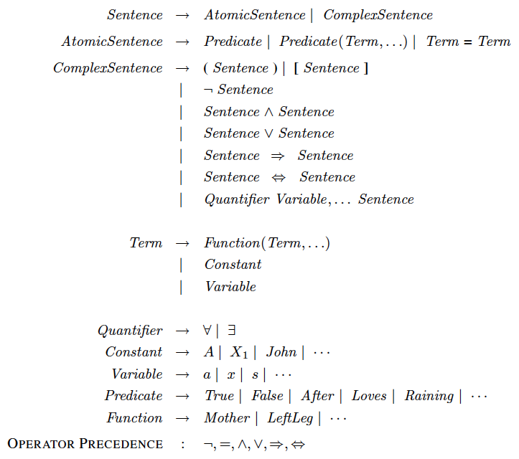
FOL: Syntax of basic elements
23

Slide 24
FOL: Symbols
Constant – objects
E.g. Richard, John, Man, Dog, 42, DarthVader
Predicate – relations or property, return true or false
E.g., FatherOf(Bill, Mary), return true or false
E.g., BrotherOf(x,y), Positive(x), Female(x), return true or false
Function – relates object(s) to one other object, return values
E.g., FatherOf(Mary), return Bill
E.g., Sum(x,y), return value of x+y
Conventions: These symbols start with upper-case letters.
24
Notes:
more formally, this is how build interpretation of whole from interpretation of parts.
predicate and relation used interchangeably; here predicate is the formal symbol and relation the real world relation
give example of tuples for functions and relations (e.g. son-of, son)

Slide 25
Headline: “Man bites dog!”
In first-order logic, we specify the objects that are involved, and describe how they relate to one another.
Bites(Man, Dog)
Predicate: Relationship among the ordered arguments.
Arguments: Objects of the world we are describing
Predicate
Arguments
25

Slide 26

Predicate-argument relations
FatherOf(DarthVader, LukeSkywalker)
BrotherOf(LukeSkywalker, PrincessLeia)
FriendOf(Chewbacca, HanSolo)
GreaterThan(Number7, Number3)
HigherThan(Everest, Kilimanjaro)
Trade(Chewbacca, PrincessLeia, LightSaber, Blaster)
ZebraFourNineAlpha(Kilimanjaro, Number7, LukeSkywalker)
26

Slide 27
Arity
Arity refers to the number of arguments for a given predicate. An n-arity predicate has n arguments.
Binary predicates have an arity of 2.
HigherThan(Everest, Kilimanjaro)
Unary predicates have arity of 1. Useful to refer to properties of an object.
HighMountain(Kilimanjaro)
Nullarity predicates have zero arguments! They are equivalent to propositions.
MoonIsMadeOfCheese()
Arity can be used to describe the number of arguments in a function as well.
27

Slide 28
Model
Domain
The set of objects that we want to reason about, e,g., Star Wars.
One possible way that the objects in a domain could be related.
A particular configuration of the domain objects.
Interpretation
Each model includes an interpretation that specifies exactly which objects, relations and functions are referred to by the constant, predicate and function symbols.
Richard → Richard the Lionheart John → King John Brother → the brotherhood relation OnHead → the on head relation
There are many possible models, each with many possible interpretations, e.g. the symbol John could map to Richard’s left leg.
28

Slide 29
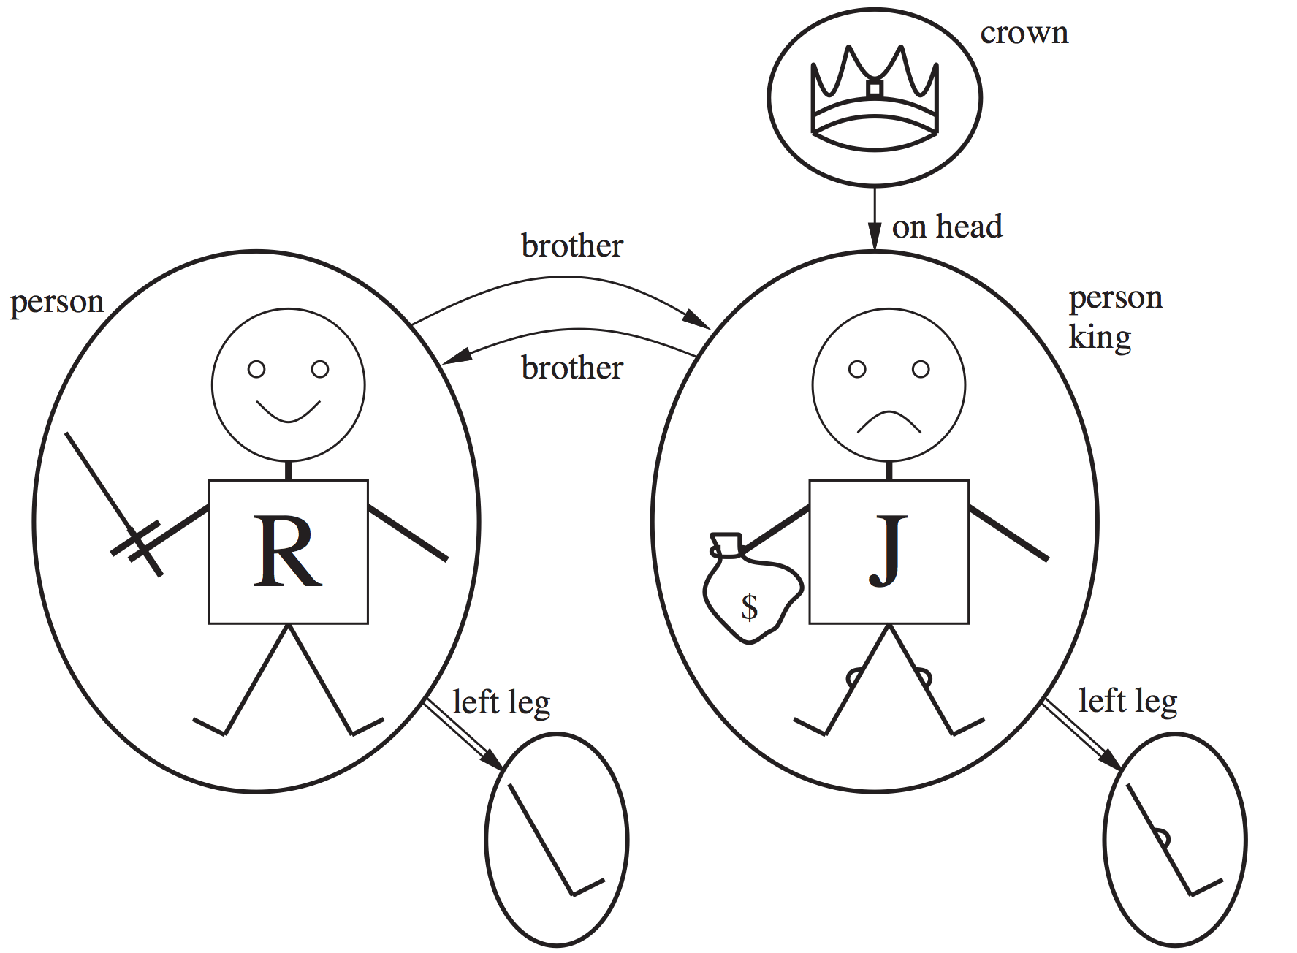
Models for FOL: Example
Constants
Richard the Lionheart, King John
Predicates
Brotherhood: {<Richard the Lionheart, King John>,
<King John, Richard the Lionheart>}
On head: {<A crown, King John>}
Person: {<Richard the Lionheart>, <King John>}
King: {<King John>}
Crown: {<A crown>}
Functions
Left leg: <Richard the Lionheart> → Richard’s left leg,
<King John> → John’s left leg
Written as tuples of objects
that are related
29
A tuple is a set of objects arranged in a fixed order, with angle brackets surrounding the objects.

Slide 30
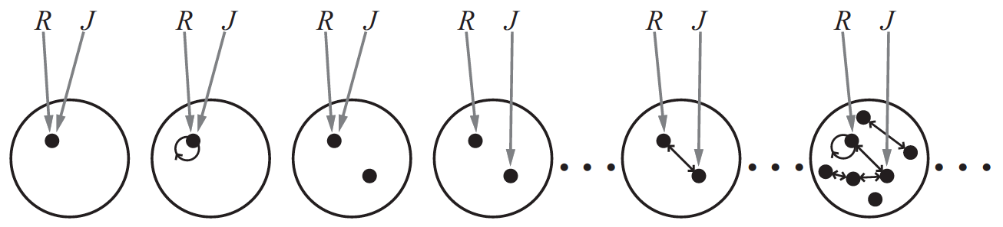
FOL: Symbols
There are objects without a name, e.g., no name was given to the crown or the legs.
One object can have multiple names
Some members of the set of all models with two constant symbols, R and J. The interpretation of each constant symbol is shown by a gray arrow. Related objects are connected by arrows.
30
Notes:
more formally, this is how build interpretation of whole from interpretation of parts.
predicate and relation used interchangeably; here predicate is the formal symbol and relation the real world relation
give example of tuples for functions and relations (e.g. son-of, son)

Slide 31
FOL: Terms and Variables
Term, a logic expression that refer to an object
A constant is a term
A variable is a term
E.g., LeftLeg(John). (LeftLeg is the function, John is the constant, LeftLeg(John) all together is a term.)
Variables can be a term by itself or serves as an argument to a function, e.g., LeftLeg(x), x is the variable and can be interpreted as constant John or constant Richard.
Variables are written in lowercase letters.
31
Notes:
more formally, this is how build interpretation of whole from interpretation of parts.
predicate and relation used interchangeably; here predicate is the formal symbol and relation the real world relation
give example of tuples for functions and relations (e.g. son-of, son)

Slide 32
Functions
Functions are just like Constants and Variables, that refer to objects in the domain.
Constants refer directly to domain objects.
e.g. Richard, John, Man, Dog, DarthVader
Variables refer to the conjunction or disjunction of domain objects.
e.g. ∀x, ∃y, Richard ⋀ John ⋀ Mary ⋀…
Functions refer indirectly to domain objects using other terms.
e.g. LeftLeg(Richard), G₂₃(x, DarthVader)
Functions look similar to predicates but returns objects instead of True/False.
32

Slide 33
Atomic sentences
Sentences are statements that evaluate to true or false.
Atomic Sentence: a single predicate-argument relation.
AtomicSentence →
Predicate | Predicate(Term, …) | Term = Term
An atomic sentence (or atom) is formed from a predicate symbol optionally followed by a list of terms such as…
Brother(Richard, John)
Married(Father(Richard), Mother(John))
>((+ x y), x)
Bites(Man, Dog)
FriendOf(Chewbacca, HanSolo)
33

Slide 34
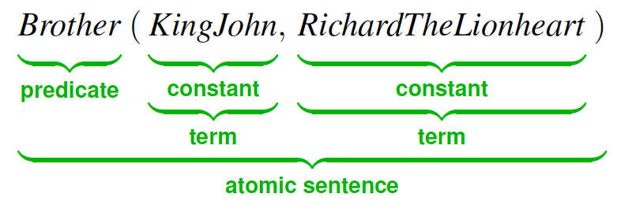
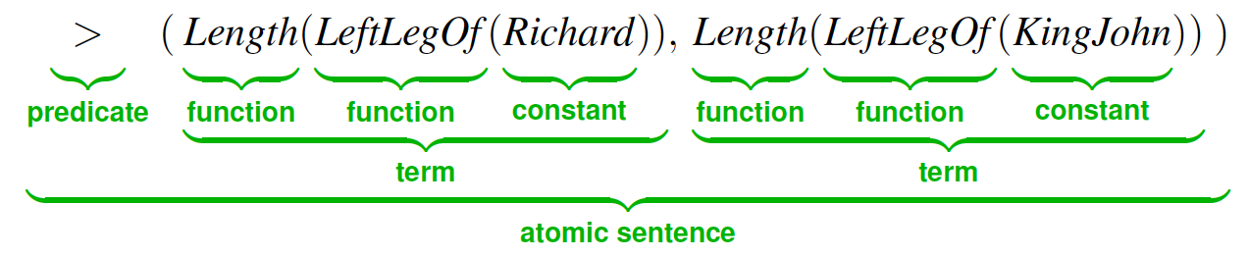
FOL: Atomic sentences
34
Bernhard Beckert, UNIVERSITÄT KOBLENZ-LANDAU

Slide 35
Semantics of atomic sentences
In general, sentences in FOL are interpreted with respect to a model
Model contains objects and relations among them
An atomic sentence, predicate(term₁, …, term_{n}), is true iff the relation referred to by predicate holds between the objects referred to by term₁, …, term_{n}
35

Slide 36
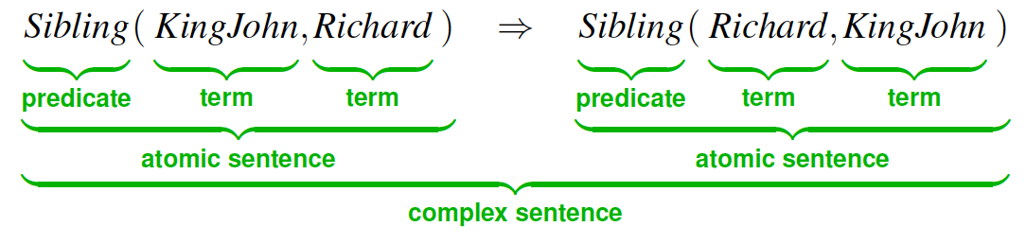
FOL: Complex sentences
Complex sentences: one or more predicate-argument relations with logical connectives.
Complex Sentence → AtomicSentence | ¬ Sentence | Sentence (⋀, ⋁, ⇒, ⟺) Sentence | Quantifier Variable, … Sentence | [Sentence]
Examples:
Bites(Dog, Man) ⋀ Owns(Man, Dog) ⇒ BadDog(Dog)
¬BadDog(Dog) ⋀ (¬Owns(Man, Dog) ⋁ ¬Bites(Man, Dog))
36

Slide 37
Logical connectives
Exactly as they are in propositional logic:
¬ Not ¬owns(Man, Dog)
⋀ And owns(Man, Dog) ⋀ bites(Dog, Man)
⋁ Or bites(Dog, Man) ⋁ bites(Man, Dog)
⇒ Implies sonOf(Luke, Vader) ⇒ parent(Vader, Luke)
⟺ Biconditional owns(Man, Dog) ⟺ ownedBy(Dog, Man)
All of the Tautologies of propositional logic are valid in First-Order Logic as well, e.g. implication elimination:
sonOf(Luke, Vader) ⇒ parentOf(Vader, Luke) ⟺
¬sonOf(Luke,Vader) ⋁ parentOf(Vader, Luke)
37

Slide 38
Quantifiers
Remember your high-school algebra class? Here’s an equation:
x² – 7x + 12 = 0
Here, the variable x must be either 3 or 4. We can read this formula as:
“There exists an x such that …”
This variable x is existentially quantified.
We also saw algebraic variables in identities:
(x + y)(x – y) = x² – y²
This identity is true for any x and y. We can read this identity as:
“For all x and y …”
These variables x and y are universally quantified.
38

Slide 39
Quantifiers
Expressing sentences about collections of objects without enumeration (naming individuals)
E.g., “All USC Trojans are clever”, “Someone in the class is sleeping”
Universal quantification (for all): ∀
Existential quantification (there exists): ∃
39

Slide 40
Exists ∃
∃ x owns(x, Dog) ⋀ bites(Dog, x)
quantifier
variable
variable scope
For all ∀
There exists an x such that x owns Dog and Dog bites x.
∀ x,y sonOf(x, y) ⇒ parentOf(y, x)
quantifier
variables
variable scope
For all x and y, if x is the son of y, then y is the parent of x.
40

Slide 41
Universal quantification: ∀
∀ <variables> <sentence>
“Every one in the CSCI561 class is smart”: ∀ x In(CSCI561, x) ⇒ Smart(x)
∀x P is true in a model, iff, for all domain elements d in the model, P is true in the model when x is interpreted by d.
∀ P – the conjunction of instantiations of P In(cs561, Sally) ⇒ Smart(Sally) ⋀ In(cs561, Dan) ⇒ Smart(Dan) ⋀ … In(cs561, Mike) ⇒ Smart(Mike)
⇒ is a natural connective to use with ∀
Common mistake: to use ⋀ in conjunction with ∀ e.g: ∀ x In(CSCI561, x) ⋀ Smart(x) means “everyone is in CSCI561 and everyone is smart”
41

Slide 42
Existential quantification: ∃
∃ <variables> <sentence>
“Someone in the cs561 class is smart”: ∃ x In(cs561, x) ⋀ Smart(x)
∃x P is true in a model, iff, there is a domain element d in the model, P is true in the model when x is interpreted by d.
∃ P – the disjunction of instantiations of P In(cs561, Sally) ⋀ Smart(Sally) ⋁ In(cs561, Dan) ⋀ Smart(Dan) ⋁ … In(cs561, Mike) ⋀ Smart(Mike)
⋀ is a natural connective to use with ∃
Common mistake: to use ⇒ in conjunction with ∃ e.g: ∃ x In(CSCI561, x) ⇒ Smart(x) is true if there is anyone that is not in CSCI561! Remember, (false ⇒ true) is valid.
42

Slide 43
Nested Quantifiers
∀x ∀y is the same as ∀y ∀x
∃x ∃y is the same as ∃y ∃x
∃x ∀y is not the same as ∀y ∃x
∀x ∃y is not the same as ∃y ∀x
∀x ∃y P(x,y) is the same as ∀x (∃y P(x,y)), which means “for every x, it is true that there exists y such that P(x,y)”
∃y ∀x P(x,y) is the same as ∃y (∀x P(x,y)), which means “there exists a y, such that it is true that for every x P(x,y)”
43

Slide 44
Nested Quantifiers
∀x ∃y Loves(x, y)
“Everybody loves somebody.”
∃y ∀x Loves(x, y)
“There is someone who is loved by everybody.”
∃x ∀y Loves(x, y)
“There is someone who loves everyone.”
∀y ∃x Loves(x, y)
“Everybody is loved by somebody.”
44

Slide 45
Quantifier negation
Quantifier duality: ∀ and ∃ can be expressed using the other, using negation.
∀x Likes(x, IceCream) ⟺ ¬∃x ¬Likes(x, IceCream)
∃x Likes(x, Broccoli) ⟺ ¬ ∀x ¬Likes(x, Brocoli)
More generally:
∀x P ⟺ ¬∃x ¬P
Hey, this looks familiar…
P ⋀ Q ⟺ ¬(¬P ⋁ ¬Q)
∀ acts like conjunction, and ∃ acts like disjunction.
De Morgan
45

Slide 46
Quantifier equivalences
∀x ¬P ⟺ ¬∃x P ∀x ¬Likes(x, Parsnips) ⟺ ¬∃x Likes(x, Parsnips)
¬∀x P ⟺ ∃x ¬P ¬∀x Likes(x, PrincessLeia) ⟺ ∃x ¬Likes(x, PrincessLeia)
∀x P ⟺ ¬∃x ¬P ∀x Likes(x, IceCream) ⟺ ¬∃x ¬Likes(x, IceCream)
¬∀x ¬P ⟺ ∃x P ¬∀x ¬Likes(x, DarthVader) ⟺ ∃x Likes(x, DarthVader)
46

Slide 47
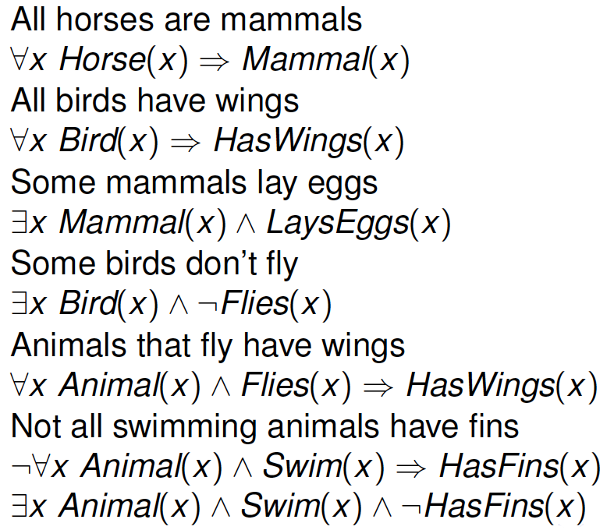
Animal Kingdom Example
47
Steven Bethard, University of Colorado

Slide 48
Kinship Example
Brothers are siblings. ∀ x, y Brother(x, y) ⇒ Sibling(x, y)
Sibling is transitive. ∀ x, y, z Sibling(x, y) ⋀ Sibling(y, z) ⇒ Sibling(x, z)
One’s mother is one’s sibling’s mother ∀ m, c, d Mother(m, c) ⋀ Sibling(c, d) ⇒ Mother(m, d)
A first cousin is a child of a parent’s sibling ∀ c, d FirstCousin(c, d) ⇔ ∃ p, ps Parent(p, d) ⋀ Sibling(p, ps) ⋀ Child(c, ps)
48

Slide 49
Translating English to FOL
Every gardener likes the sun.
∀ x gardener(x) ⇒ likes(x,Sun)
You can fool some of the people all of the time.
∃ x ∀ t (person(x) ⋀ time(t)) ⇒ can-fool(x,t)
You can fool all of the people some of the time.
∀ x person(x) ⇒ ∃ t time(t) ⋀ can-fool(x,t)
All purple mushrooms are poisonous.
∀ x (mushroom(x) ⋀ purple(x)) ⇒ poisonous(x)
49

Slide 50
Translating English to FOL
No purple mushroom is poisonous.
(∃ x)(∃ y)(∀z) mushroom(x) ⋀ purple(x) ⋀ mushroom(y) ⋀ purple(y) ⋀ ¬(x=y) ⋀ mushroom(z) ⋀ purple(z)
⇒ ((x=z) ⋁ (y=z))
50

Slide 51
Translating English to FOL
No purple mushroom is poisonous.
¬(∃ x) purple(x) ⋀ mushroom(x) ⋀ poisonous(x)
or, equivalently,
(∀ x) (mushroom(x) ⋀ purple(x)) ⇒ ¬poisonous(x)
51

Slide 52
Translating English to FOL
No purple mushroom is poisonous.
¬(∃ x) purple(x) ⋀ mushroom(x) ⋀ poisonous(x)
or, equivalently,
(∀ x) (mushroom(x) ⋀ purple(x)) ⇒ ¬poisonous(x)
There are exactly two purple mushrooms.
52

Slide 53
Translating English to FOL
No purple mushroom is poisonous.
¬(∃ x) purple(x) ⋀ mushroom(x) ⋀ poisonous(x)
or, equivalently,
(∀ x) (mushroom(x) ⋀ purple(x)) ⇒ ¬poisonous(x)
There are exactly two purple mushrooms.
(∃ x)(∃ y)(∀z) mushroom(x) ⋀ purple(x) ⋀ mushroom(y) ⋀ purple(y) ⋀ ¬(x=y) ⋀ mushroom(z) ⋀ purple(z)
⇒ ((x=z) ⋁ (y=z))
53

Slide 54
Translating English to FOL
Deb is not tall.
¬tall(Deb)
X is above Y iff X is on directly on top of Y or else there is a pile of one or more other objects directly on top of one another starting with X and ending with Y.
(∀ x)(∀ y) above(x,y) ⟺
(on(x,y) ⋁ (∃ z) (on(x,z) ⋀ above(z,y)))
54

Slide 55
Translating English to FOL
Deb is not tall.
¬tall(Deb)
X is above Y iff X is on directly on top of Y or else there is a pile of one or more other objects directly on top of one another starting with X and ending with Y.
(∀ x)(∀ y) above(x,y) ⟺
(on(x,y) ⋁ (∃ z) (on(x,z) ⋀ above(z,y)))
55

Slide 56
Equality
term₁ = term₂ is true under a given interpretation, iff, term₁ and term₂ refer to the same object
E.g., definition of Sibling in terms of Parent:
∀x,y Sibling(x,y) ⇔ (¬(x = y) ∧
∃ m,f (¬(m = f) ∧
Parent(m,x) ∧ Parent(f,x) ∧
Parent(m,y) ∧ Parent(f,y)))
56

Slide 57
Wumpus World Example
57
Steven Bethard, University of Colorado

